Slide 1
Ocr based crvs form digitalization
1805064-Sanju Basak
1805074-Razin Reaz Abedin
1805080-Erfan Jahangir

Slide 2
What is an OCR?

Slide 3
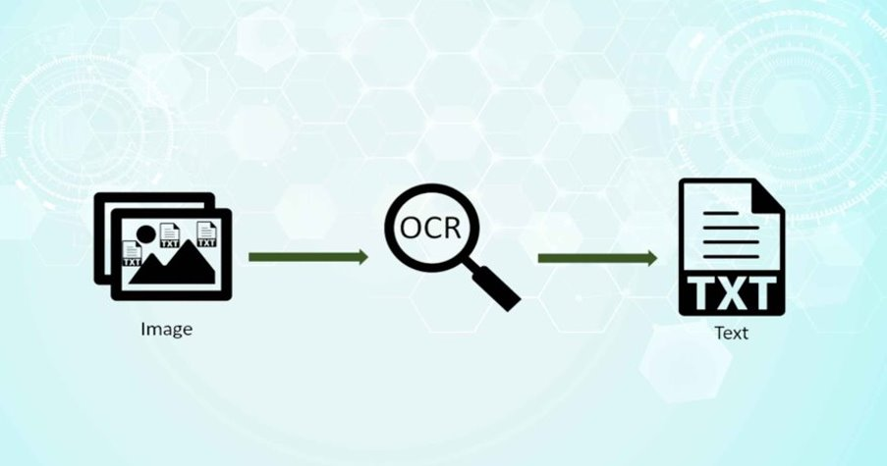
Optical character Recognition

Slide 4
WHAT IS CRVS?
Civil Registration and Vital Statistics

Slide 5
না
টো
র

Slide 6


Slide 7
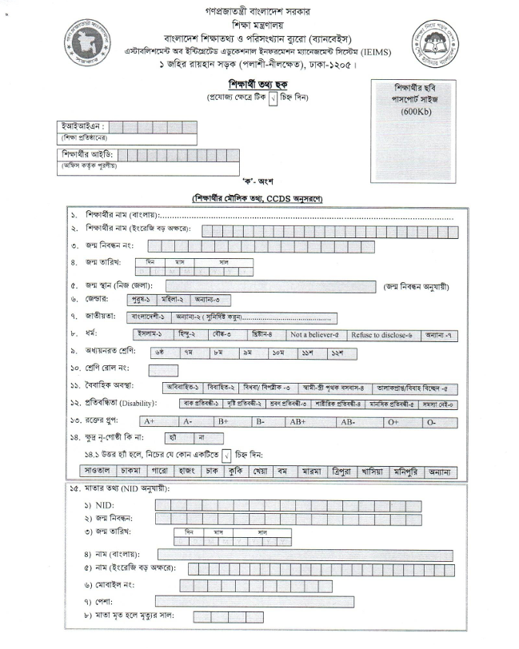

Slide 8
Motivation

Slide 9
It took me three days to input all the 60 forms into the banbeis website.
“
”
Rafan Jahangir, a teacher at a local school

Slide 10
modules

Slide 11




INPUT
VALIDATION
OCR
Splicing
Post-processing

Slide 12
Multiple user concurrency
Save Draft Functionality
Data analytics
OCR
INPUT
VALIDATION
Splicing
Pipelining
Audit, Review and Approval
Post-processing

Slide 13



SOME POSSIBLE INPUT VALIDATIONS
FIXED FIELDS
Checkbox verification
review
Erroneous inputs like spelling mistakes of known inputs will be corrected from the best match
Blood Group & another checkbox verification
Final matching side-by-side filled up form

Slide 14
Scopes
Fixed Fields
Erroneous inputs like spelling mistakes of known inputs will be corrected from the best match

Slide 15
Scopes
Checkbox verification
Blood group & other checkbox verification

Slide 16
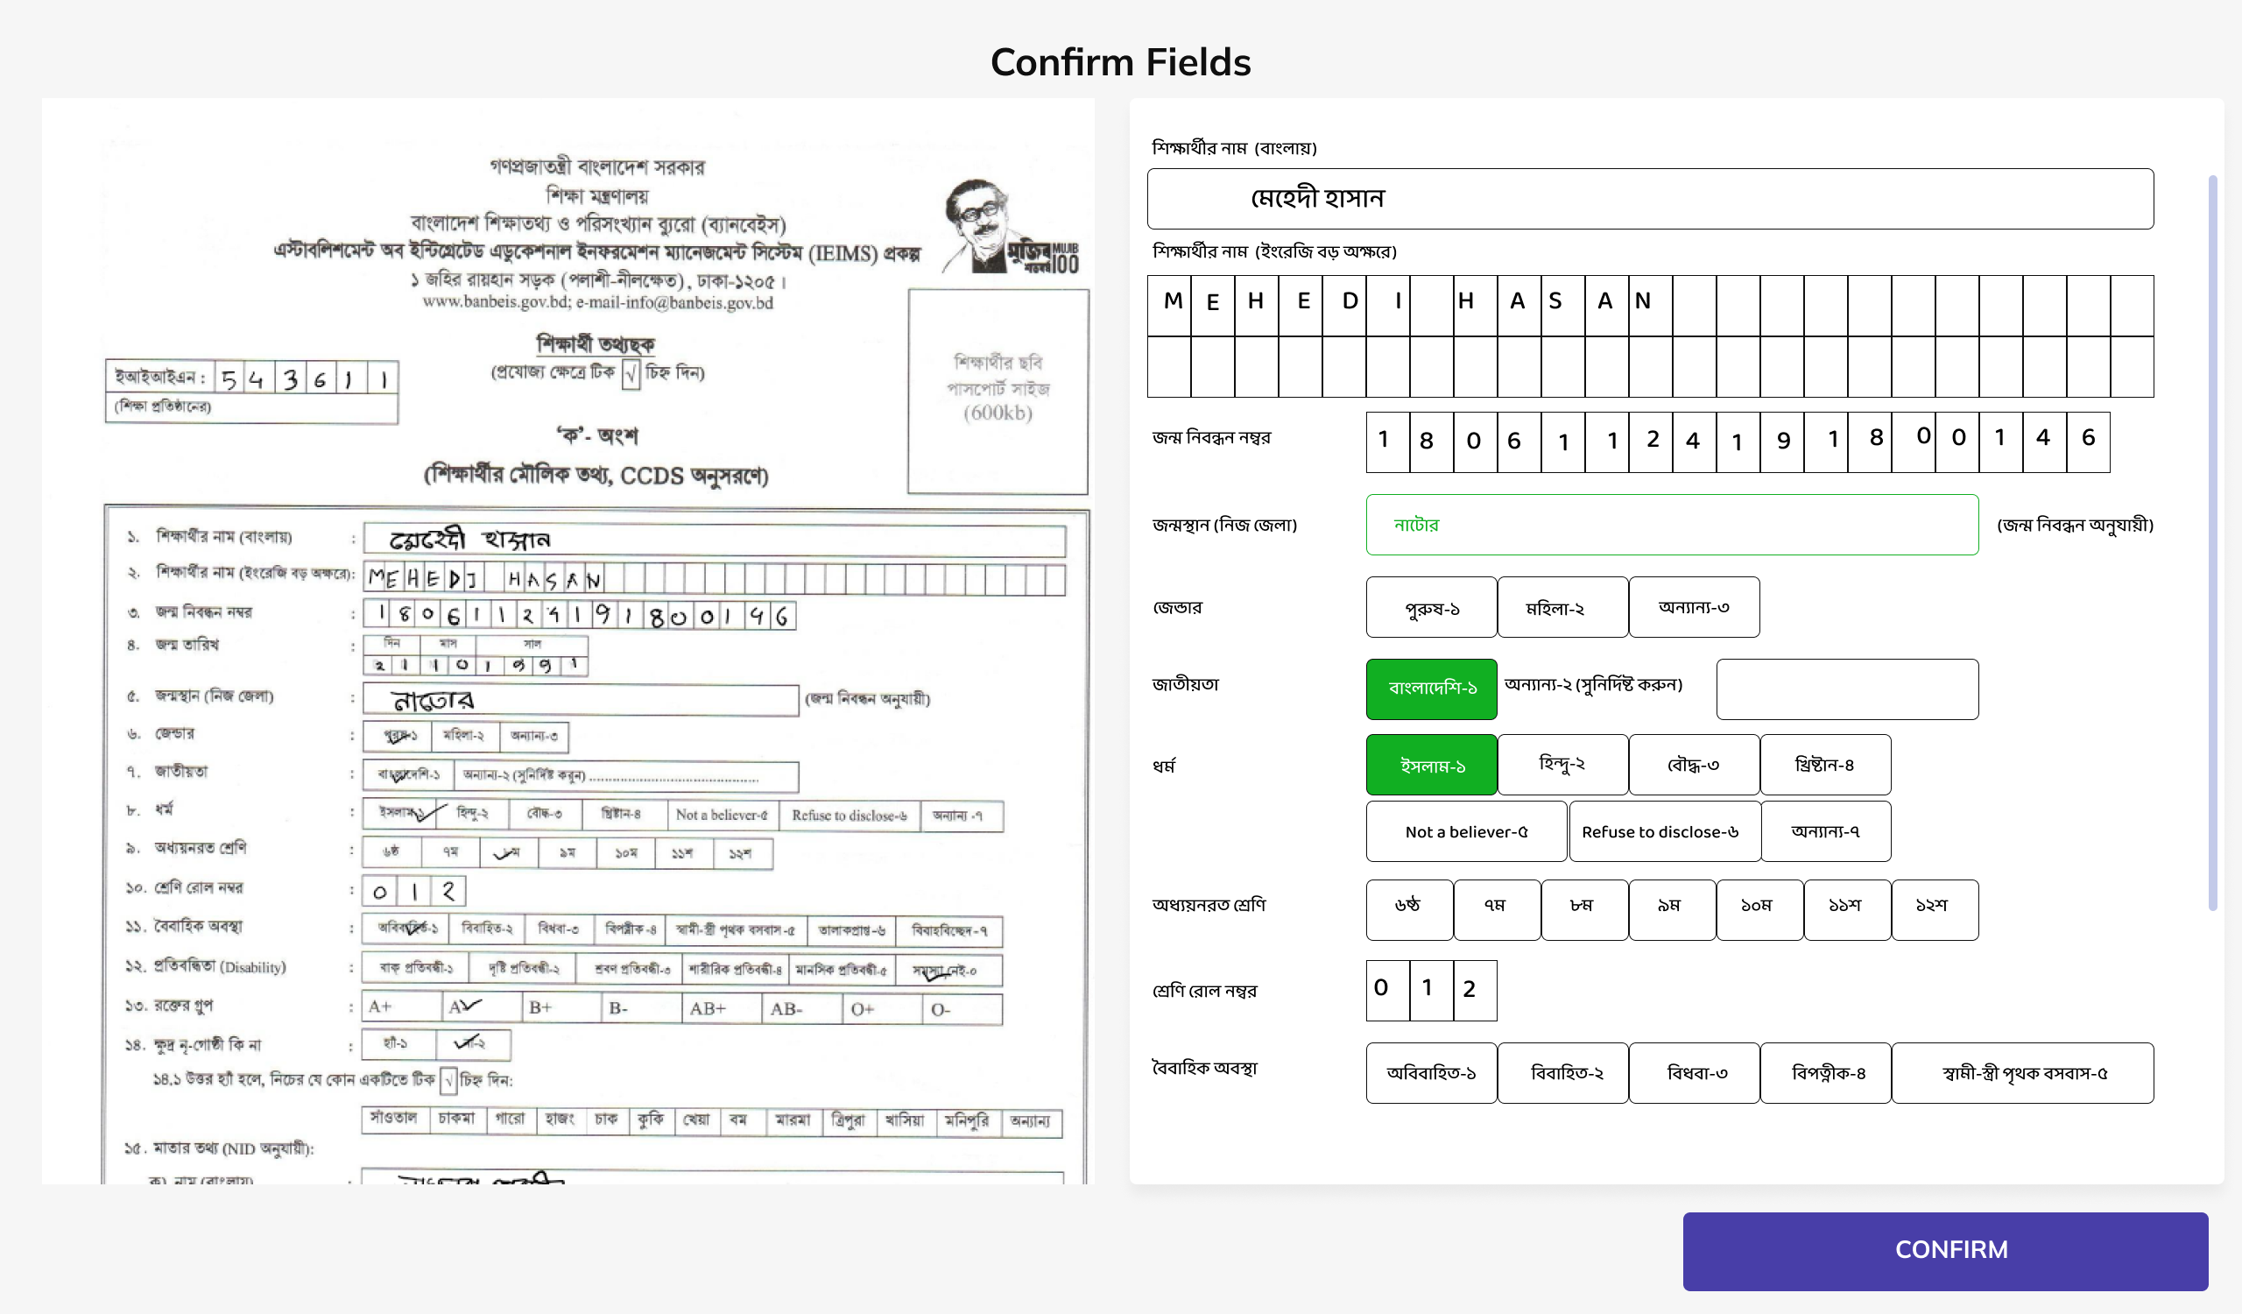
Scopes
Review
Final matching side-by-side
filled up form

Slide 17
THANK YOU

